Slide 1
Unit 2
Topic:
Company organization chart
Company objective

Slide 2
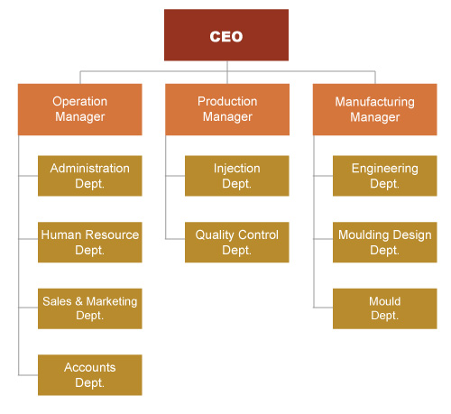
Company organization chart

Slide 3
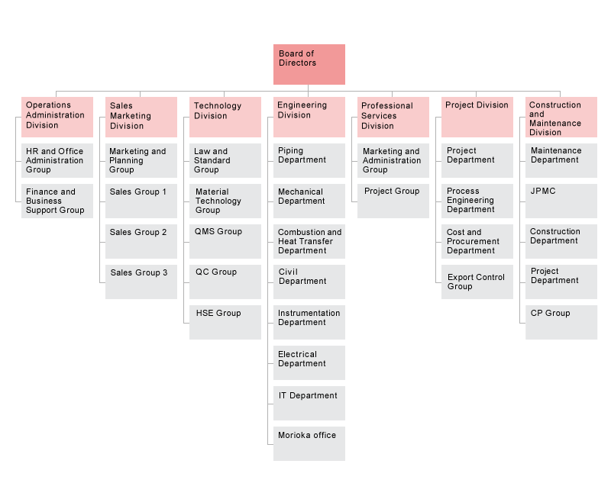
Company organization chart

Slide 4
Company organization chart

Slide 5
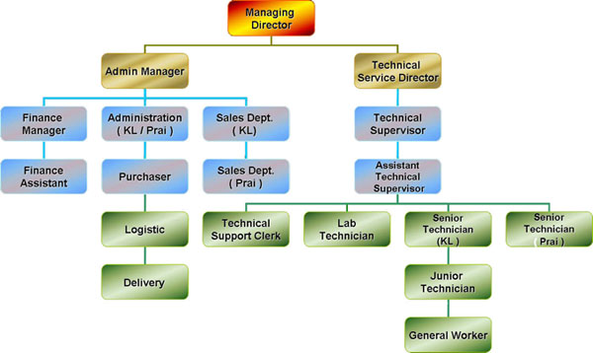
Company organization chart

Slide 6
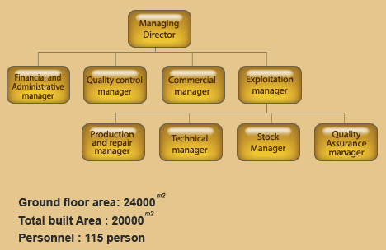
Company organization chart

Slide 7
Company objective
1. Describe information about a company.
2. Identify functions of departments in company.
3. Meeting Office Staff.

Slide 8
Functions of different department
• The Sales Department takes care :
➢ Selling product to customers
• The Marketing Department is responsible for :
➢ Carrying out market research.
• The Production department looks after:
➢ Working to improve the company’s production

Slide 9
Functions of different department
• The legal department looks after:
➢ Drawing up contract
• The Research and Development takes care of:
➢ Working with the factory unit.
• The Personnel department looks after
➢ Recruitment and selection

Slide 10
Functions of different department
• The accounts department takes care of :
➢ Paying wages and salaries
• The transport department is responsible for :
➢ Operating the company’s vans and cars
• The Purchasing department looks after :
➢ Ordering all supplies needed by the company

Slide 11
Functions of different department
• The Finance department takes care of :
➢ Budget of the company

